Slide 1

Development of Social for Restaurant Recommendation Project
Present by
Mr.Nattawat Rajchompu 5704062637019 CSB
Adviser

Slide 2

Background
Nowadays, rapid the rapid development of wireless technology and mobile has evolved so that data can be easily accessed.

Slide 3



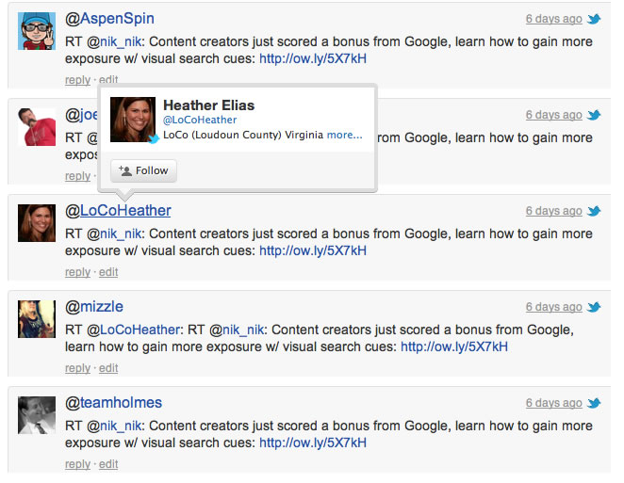

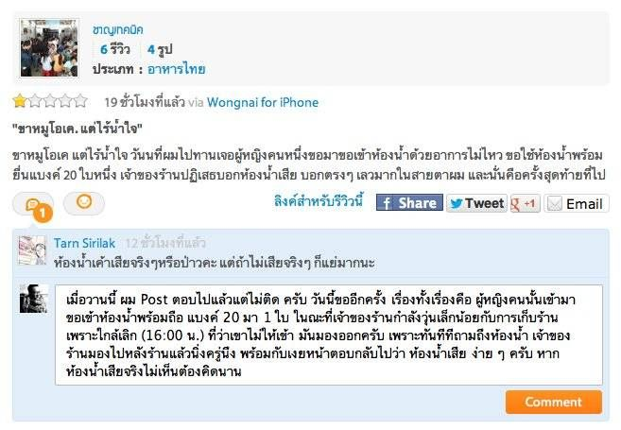

For example, you can choose to eat but do not know where delicious.
BAD
Best

Slide 4

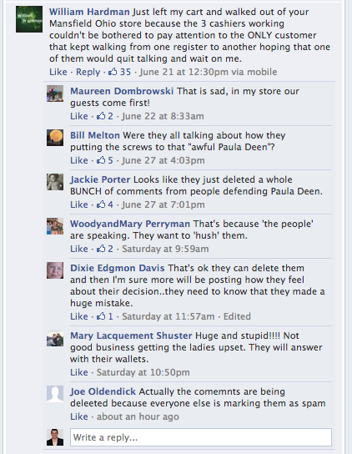

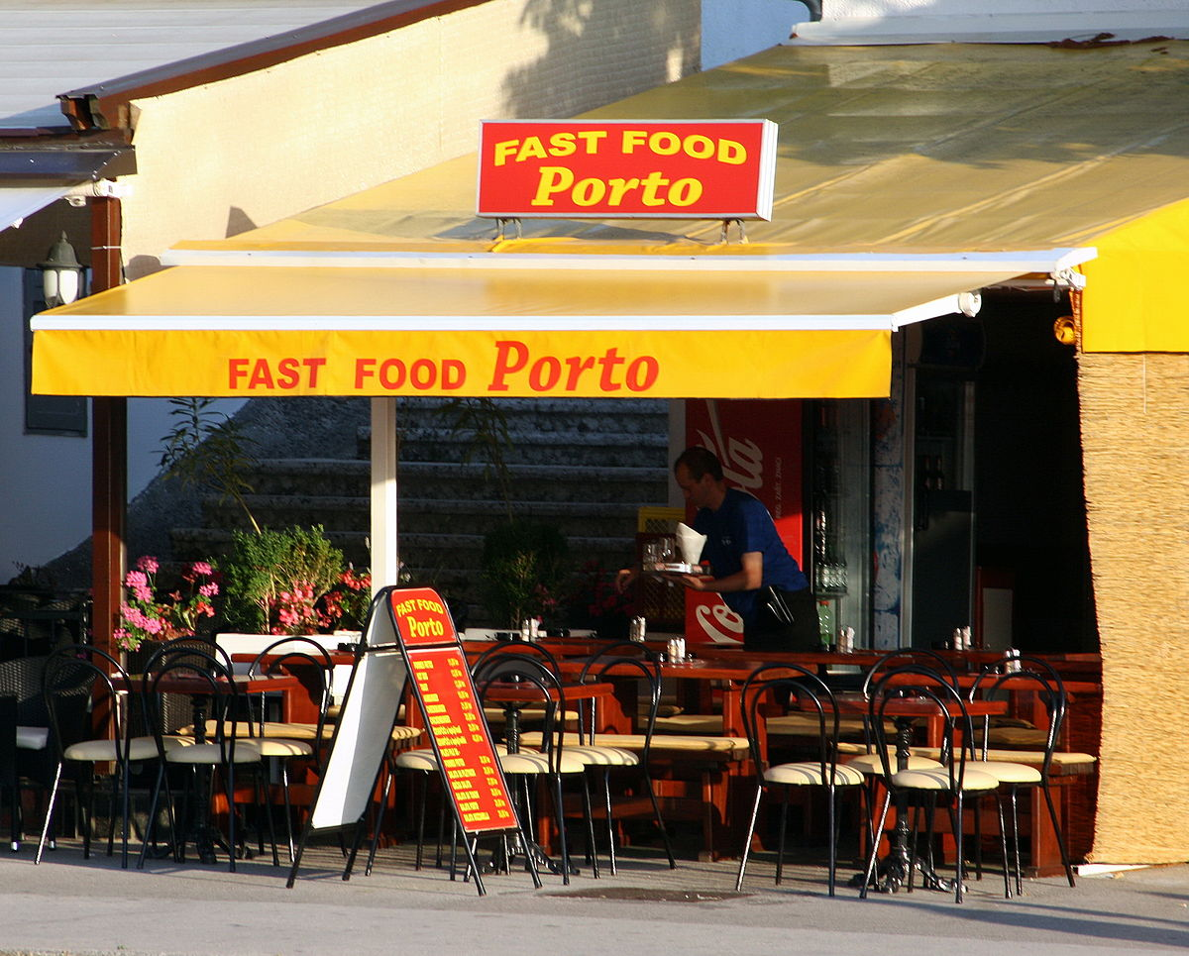

Due to the explosive growth of social media contents, people usually experience information seeking.

Slide 5
Why not have the tools to decide on restaurants?
They demand a tools which could automatically monitor and perform real-time sentiment analysis on the large contents to enhance the user’s search experience.

Slide 6
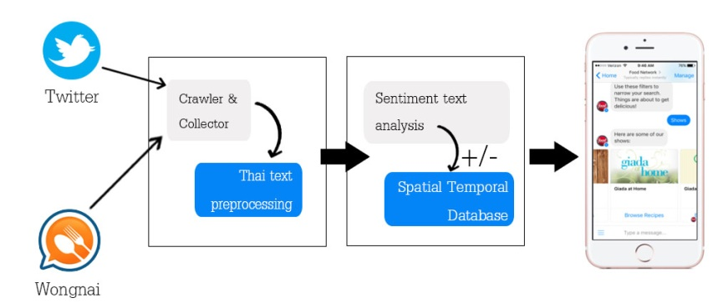
In this Project
We propose a social sensing tools for monitoring and performing real-time analysis if review text in the social media contents
retrieval part:
analysis part:
communication part

Slide 7
Project Objectives
Design and develop an automated tool to monitor and suggest restaurants to analyze social media content.

Slide 8
Scope of the project
We only focus on the restaurants in Bangkok and available in Wongnai.
We retrieve only Thai review texts from two popular social media: Wongnai and Twitter.
We implement a rule-based chatbot on Line Chatbot or Facebook platform using Wit.ai with simple questions.

Slide 9
Benefits
To improve user’s search experience in restaurant seeking.
- Restaurant owners could seek real-time feedback from customers to improve Customer Relationship
Management (CRM).

Slide 10
Tools and equipment used in the project
-JAVA
-Android Studios
-Photoshop
-Illustrator
-Chatbot tools
-Chatbot line platform

